Slide 2
Lesson # 4: DevOps World Review\ Clearance

Slide 4
DevOps Intro:
Application Physical Architecture Model
Lifecycle of Application Development:
From Code to Artifact
Terms and Tool types
The DevOps Infinity Loop
The DevOps Infrastructure:
How the Infrastructure Built
DevOps 2.0 (Extra Subject):
Intro: the gap between Dev & Operations (or unleash the developers)
Changing the focus to the business (both Dev wize & Operational)
Changing the operational attention
SCM (Git):
What is SCM, and Why
Basic Operations With Git
Introduction to Git Flow
(extra) Automating Processes with Git – Git hooks

Slide 5
The DevOps Infinity loop

Slide 6
Application Physical Architecture Model

Slide 7
Application Architecture Models
Application Logical Architecture Model
Application Physical Architecture Model
Application
Applicative Infrastructure
Infrastructure
app1 (Jar\War\Package)
app2(Jar\War\Package)
app 3(Jar\War\Package)
web server
application server
databases
EBS\QM
OS
(Virtualization)
Hardware
Applicative Networking
Load Balancing
WAF
Web Apps (3-tier)
Web Apps (2-tier)
WEB
APP
DB
WEB+APP
DB

Slide 8
From Code to artifact

Slide 9
Software build - Introduction
Another view of how to distinct Programing Languages:
Compiled Languages
Interpreted Languages
Legacy Programing languages (c\c++\go)
CODE
COMPILE
RUNNING PROGRAM
Modern Programing languages (Java\Scala\C#\J#)
CODE
COMPILE
RUN TIME COMPILE (JIT)
RUNNING PROGRAM
Interpreted Programing languages (JS\PHP\Python\Ruby)
CODE
Interpreter (runtime compiler)
RUNNING PROGRAM
Ready to run on the machine

Slide 10
Software build review
Build tools vs Build Framework vs Packaging
BUILD FRAMEWORK
Build Framework: a framework used to automate all process involved in the ”build” could include the following: - perform unit tests on the code project
- Perform a mini deployment ( very used in the past)
Managed package management for the code project
- For interpreted language, “package” the code project, to a single file or single zipped folder
BUILD tool: - perform the compilation process of the code project
BUILD TOOL

Slide 11
Software build review

Slide 12
DevOps 2.0 Flow

Slide 13
DevOps
DEV
OPS
PLAN
CODE
BUILD
TEST
RELEASE
DEPLOY
OPERATE
Monitor
DevOps
Continuous Delivery
VALUE
Continuous Integration
Agile Development
COLLABORATION

Slide 14
PLAN
PLAN
CODE
BUILD
TEST
RELEASE
DEPLOY
OPERATE
Monitor
PLAN: Planning the features that will include on the planned release (sprint)
If the org\team is working in agile related methodology (SCRUM)
Utilities used:
JIRA
TFS (story management)
GITHUB (Issues part)

Slide 15
CODE
PLAN
CODE
BUILD
TEST
RELEASE
DEPLOY
OPERATE
Monitor
CODE: Development process itself,
In case org team uses TDD (test driven design), unit-test will also take place here ( the developers are obligated to perform commit & push, only when all unit-tests passed
Utilities used:
Usually related to the language
IDE ( Integrated development environment)
Visual Studio, Visual Code, InteliJ, Atom, WebStorm Eclipse

Slide 16
BUILD
PLAN
CODE
BUILD
TEST
RELEASE
DEPLOY
OPERATE
Monitor
BUILD: creating the code related artifact from the code:
In case unit-tests are exist, code coverage is checked
In case there is demanding of performing security related tests, they will take place here.
In case the “operational” environment will be containerized, docker image will be prepared
Build Tools & framework are programing language related
Build Frameworks:
Java\Scala: maven, gradle ,ant
JavaScript\Node.js: npm,
.NET\ c\c++ (win): Msbuild
c\c++ (lin): make
Build tools (compiler\package):
Java\Scala: java compiler
JavaScript\PHP: webpack (and any other)
.NET: csc.exe
c\c++ (lin): cgg
Utilities used:
JENKINS
TFS (build management)
GITHUB (build part)
The output of this step are: binary file and or docker file ARTIFACT
Please note: in some orgs, some or all tests taken place here, may move to the next phase

Slide 17
TEST
PLAN
CODE
BUILD
TEST
RELEASE
DEPLOY
OPERATE
Monitor
TEST: here there some tests conducted to measure the Quality of the artifacts created in the past phases. If artifact doesn’t comply with the wanted results, the process may fail (e.g, code coverage in the artifact is less than 80%. ).
Stress tests may occur here
Manual acceptance tests occur here
Utilities used:
Junit and more

Slide 18
RELEASE
PLAN
CODE
BUILD
TEST
RELEASE
DEPLOY
OPERATE
Monitor
RELEASE: Placing the artifact (jar or\and docker file) in the artifactory,
* In case artifact already located there, performing “promote” to it, any adding proper tags
Utilities used:
Artifactory (nexus\antifactory)

Slide 19
DEPLOY
PLAN
CODE
BUILD
TEST
RELEASE
DEPLOY
OPERATE
Monitor
DEPLOY: Performing the actual deployment of the artifact into the operational environment.
Could be push to tomcat\apache\iis
Could be push to k8s\openstack\swarm
Utilities used:
Ansible, Chef, Puppet
Terraform

Slide 20
OPERATE
PLAN
CODE
BUILD
TEST
RELEASE
DEPLOY
OPERATE
Monitor
PLAN: operating the liveliness of the artifact deployed earlier
Utilities used:
Containers (Docker Swarm\K8S\openstack)
Web Servers (tomcat\apache\iis\)

Slide 21
MONITOR
PLAN
CODE
BUILD
TEST
RELEASE
DEPLOY
OPERATE
Monitor
Monitor: here we are conducting some monitors checks, those are the types:
Operational monitor (if the artifact if function properly)- results 1 of three options (OK,ERROR,WARNING)
Performance Monitoring (AKA APM): collecting performance metrics or business KPI, so with correlation we can estimate the operational costs of the artifact
Utilities used:
Prometheus, Grafana
ELK (&\log stash)
Nagios\

Slide 22





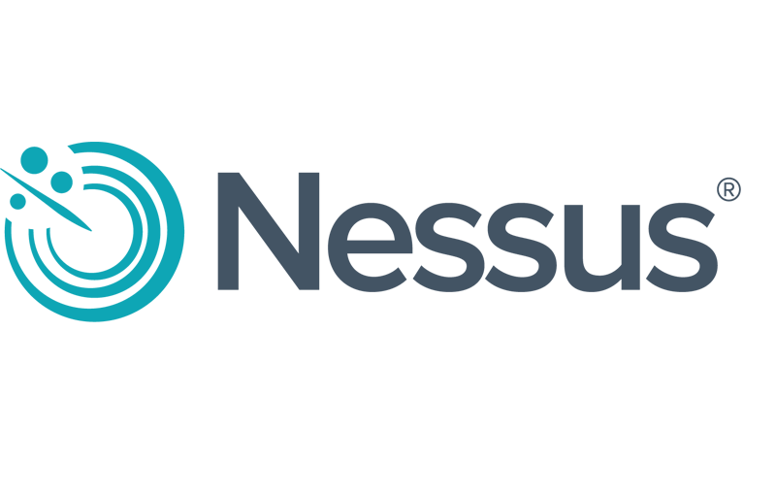



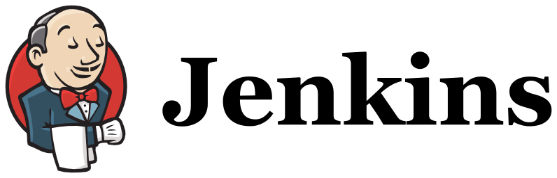
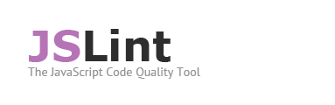

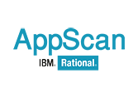



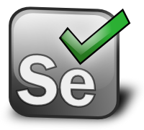
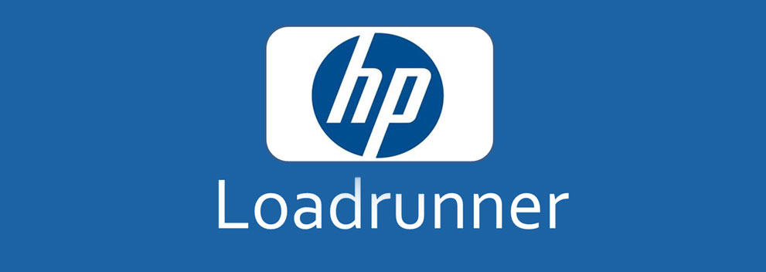


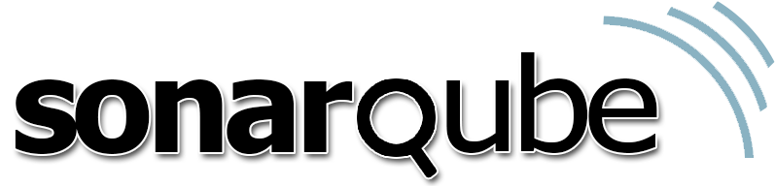



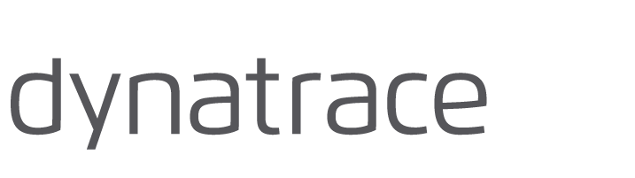


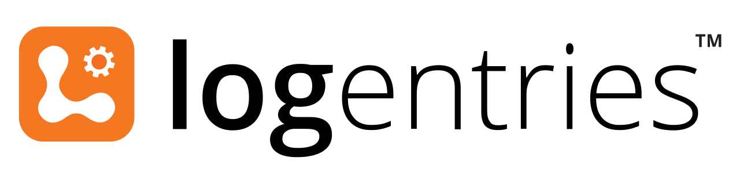

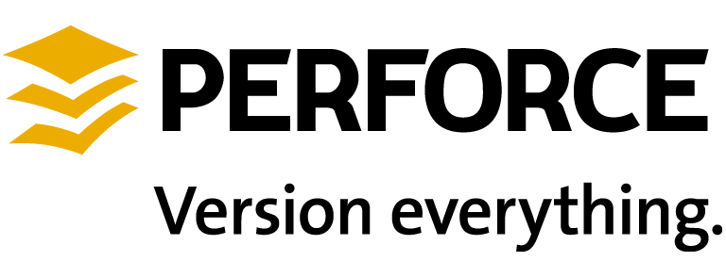

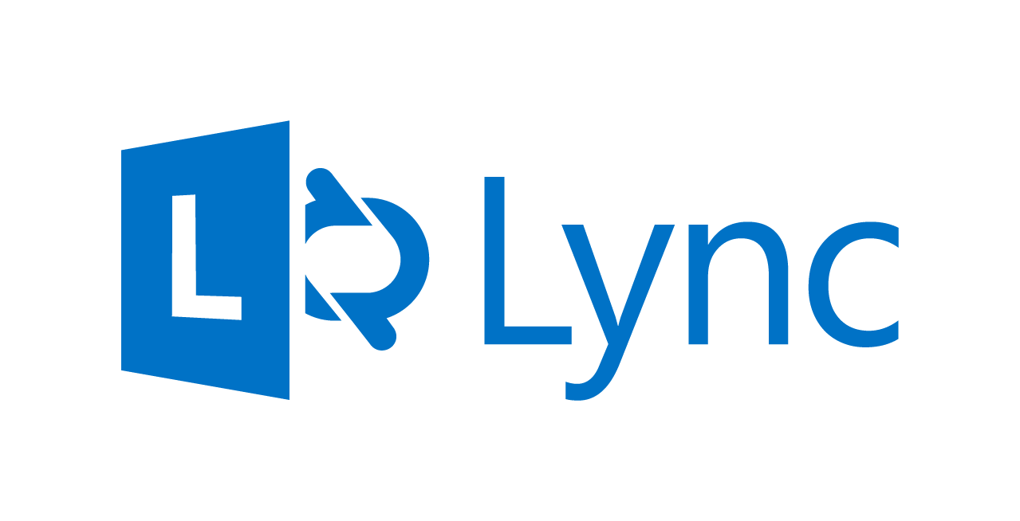
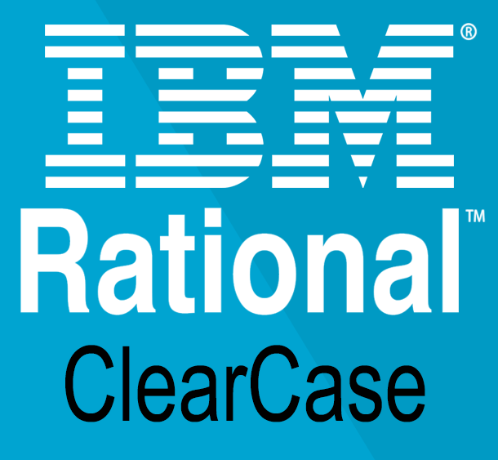
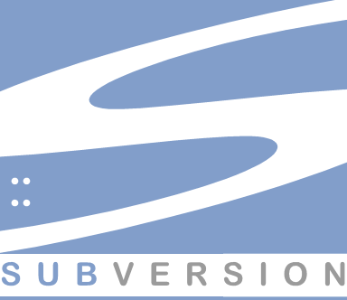

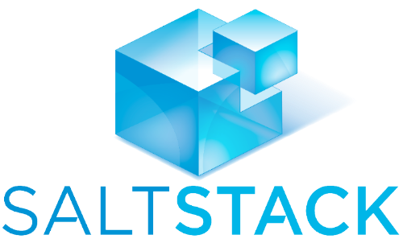
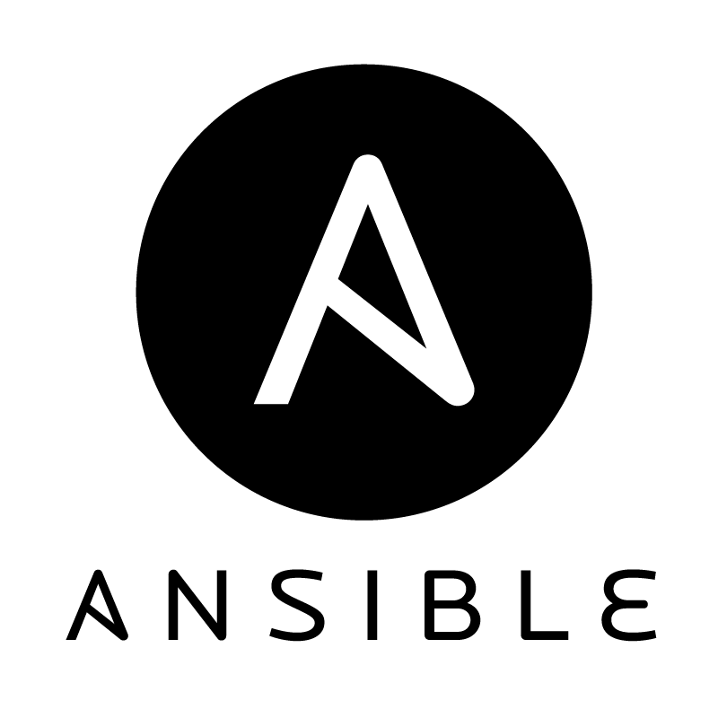
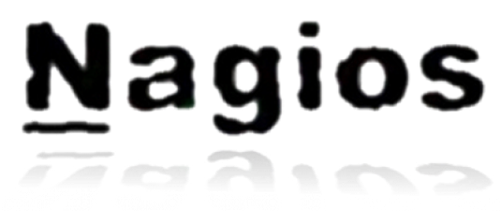


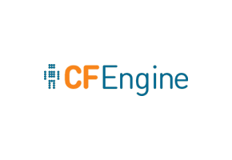



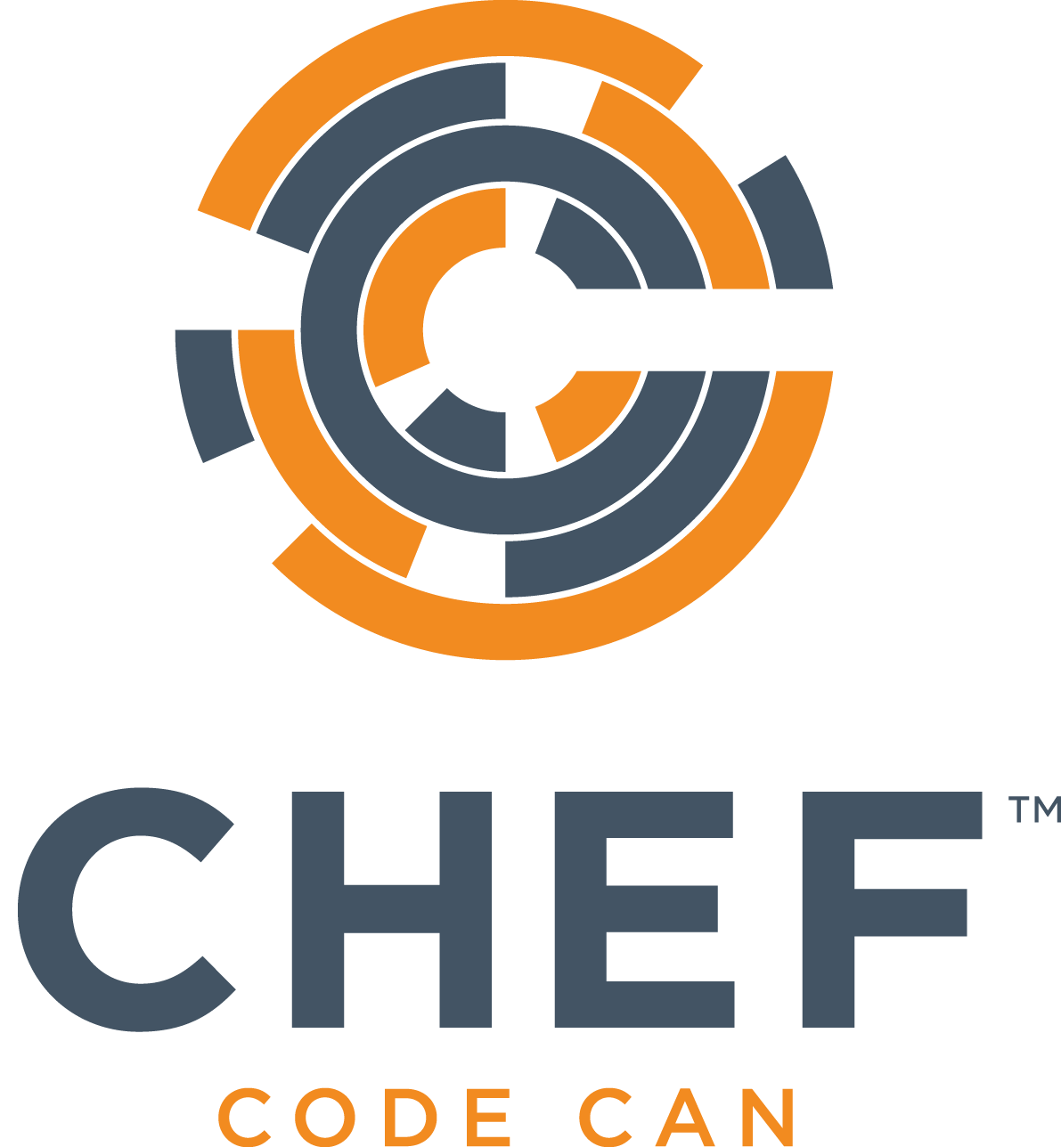
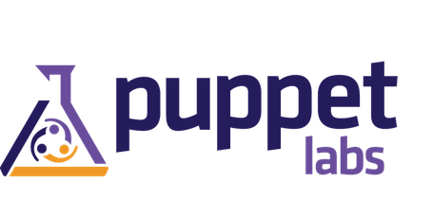
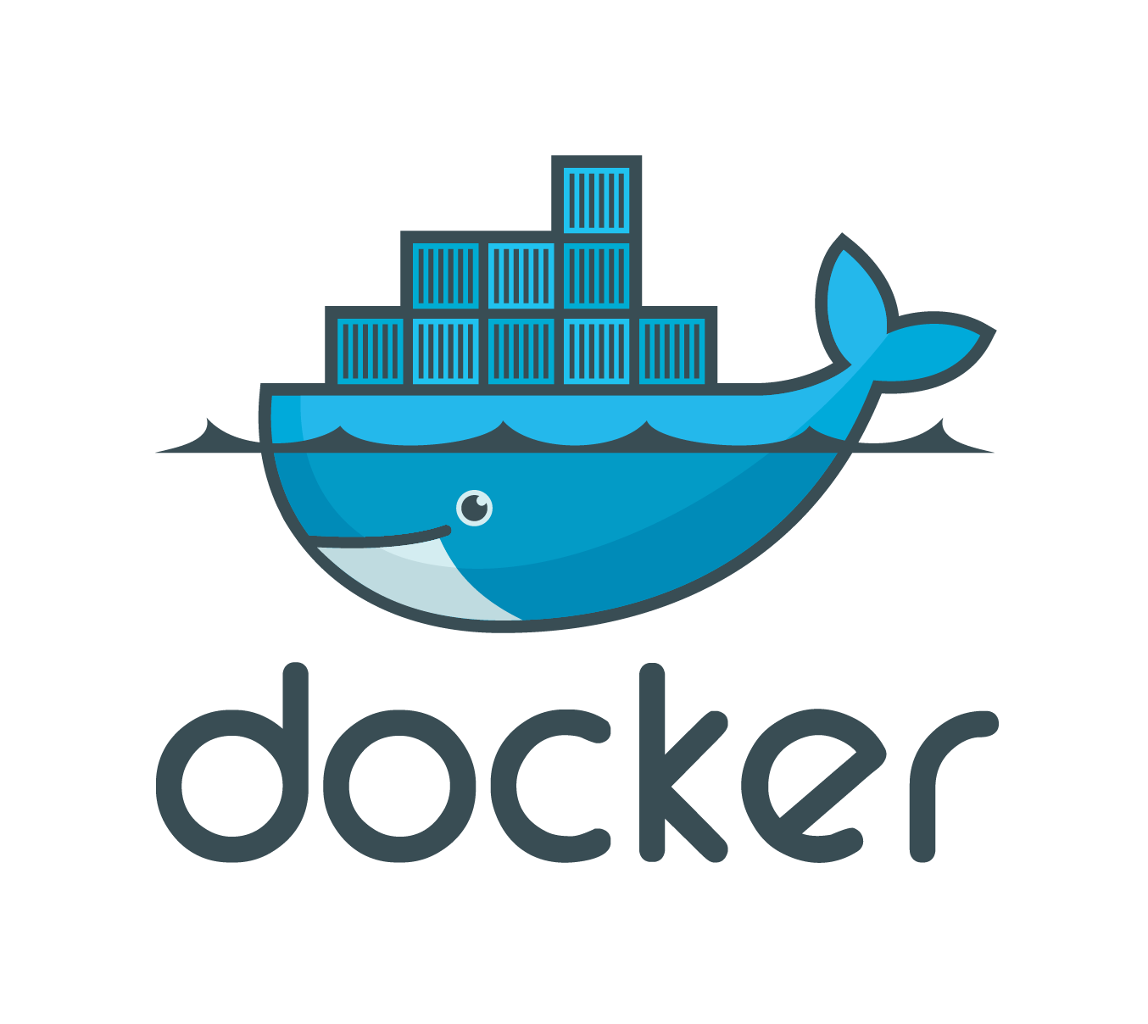
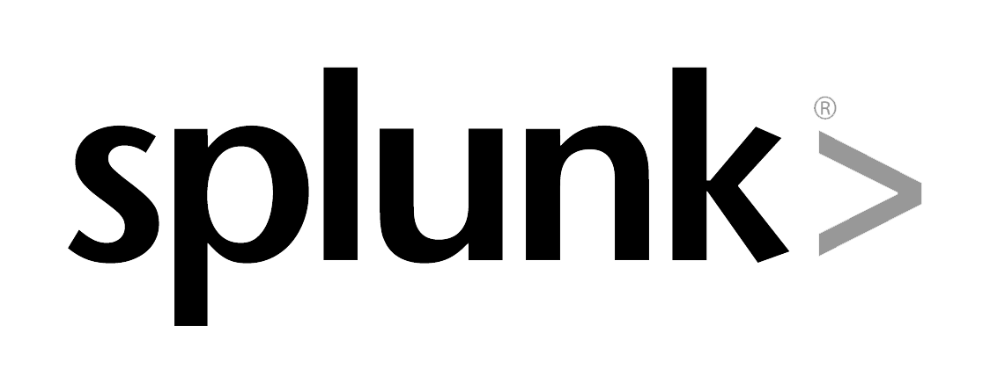






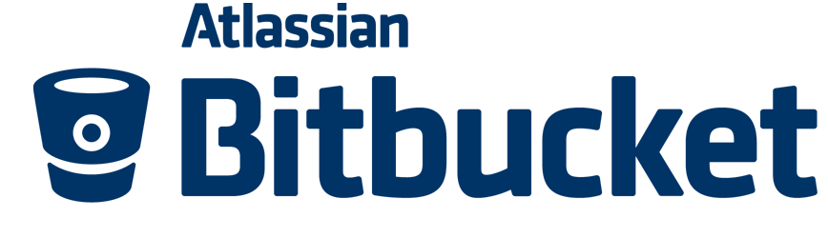



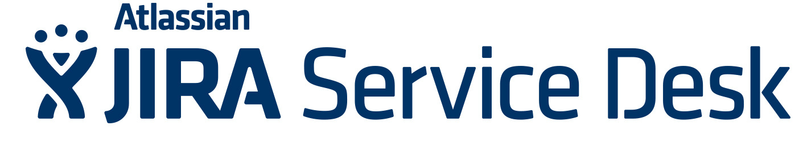
Tools Landscape
Continuous Integration
Testing
Build & Deploy | CI Server | Unit Testing | Code Quality
Automated Acceptance |  | NFR Testing
Version Control
Configuration Management & Environment Provisioning
Monitoring & Alerts
Project & Support Management
Source Control | Binary Management
Productivity Add On
Application & Infra Monitoring | Log Monitoring
Collab / Community | Chat
Project Lifecycle Management | Service Desk
Source Control Binary Management Productivity Add On
Notes:
Highlight tools that we used.

Slide 23
DevOps 2.0 (Extra Subject):

Slide 24
Operational environment of our ARTIFACT
Application server
View of operational Environment (Legacy):
App 1
Machine
Operation Systems
App 2
What Bad here? - need to wait for Infra - and when it comes to infra, at least 3 teams are involved: - Networking - VMware - OS Specialist What was the Solutions?
App 3
Load Balancer
DEVOPS 1.0
Multi skill personal, that created Automated process for the CD flow
But the problem not been solved yet…

Slide 25
Operational environment of our ARTIFACT
Tools used:
Application server
App 1
Machine
Infra Description tools:
- Terraform - CloudFormation and more…
Operation Systems
App 2
Configuration Tools:
- Ansible, Chef, Puppet
App 3
Load Balancer

